Slide 1

Dublin R
El Dorado competition 2016
Mihai Todor, Software Engineer,
Kevin Eid, Data Engineer,
team miner49er

Slide 2
Introduction
Used Python
Scipy, Scikit-Learn, Matplotlib / Plotly
Strategy
Get the optimal cluster in terms of amount of gold and elevation
Find which parcels belong to this cluster
Pick the 5 most profitable parcels and focus our investment plan on them

Slide 3
Data Preprocessing
Elevation: continuous → categorical values:
3 elevation categories for fixed costs
3 elevation categories for variable costs
Linear Regression on the costs_data

Slide 4
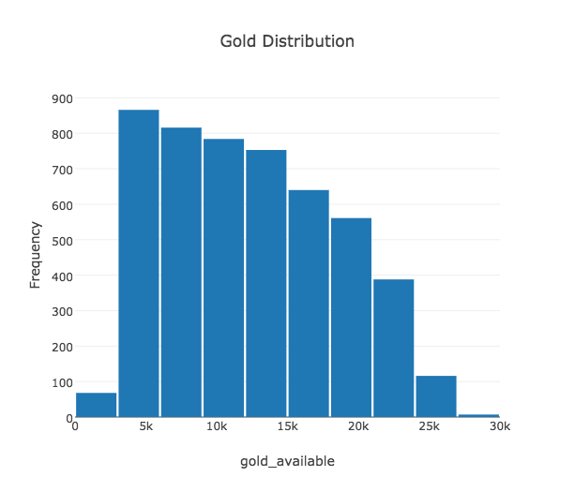
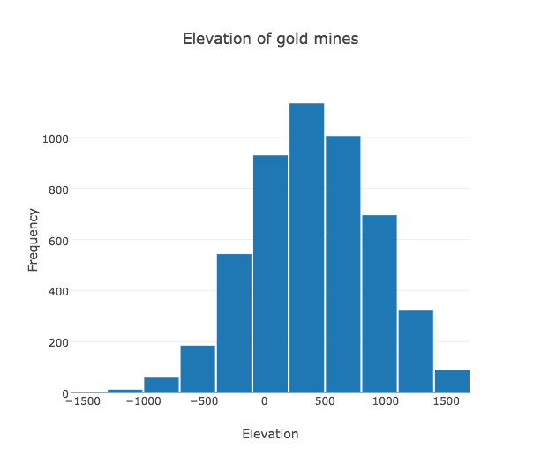
Data Exploration

Slide 5
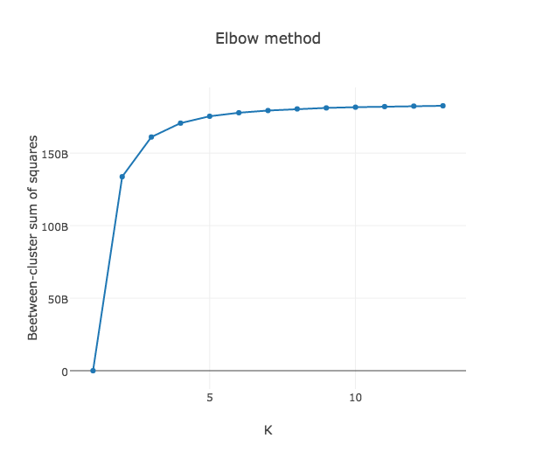
Clustering - K-means
Clustering on gold_available and elevation
Elbow method: computing and plotting the between-cluster sum of squares.
bss = total_sum_of_squares - within-cluster_sum_of_squares
K = 3
Notes:
internal cohesion and external separation

Slide 6
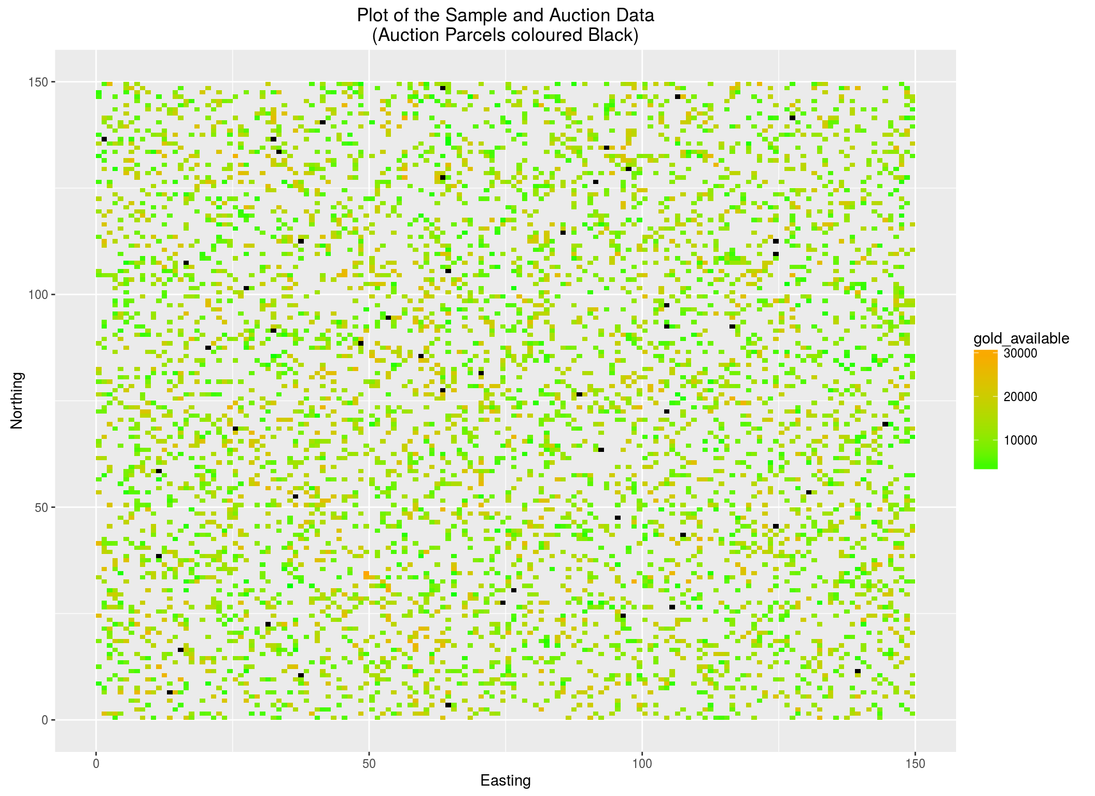

Slide 7
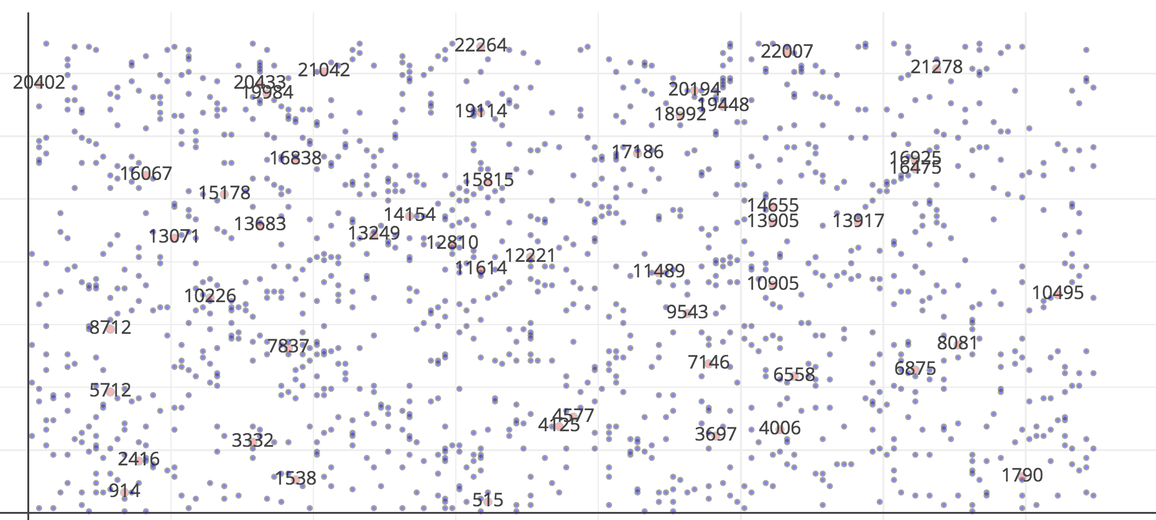
First filtering of the parcels
top_parcel_ids = [10226, 7837, 19114, 20194, 11489,10905,1790,13249,14154,12810,1614,12221]

Slide 8
Another idea for filtering
Compute average gold amount around each parcel
Hope that Mick did not choose the gold quantities under neighbouring parcels at random :)

Slide 9
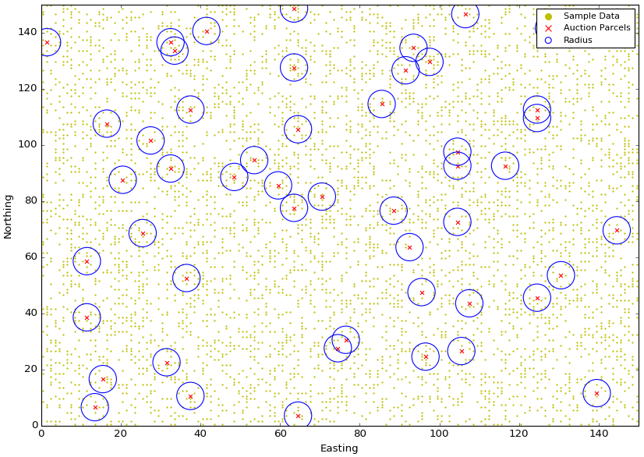

Slide 10
Empirical area radius selection
Try radius = 1 .. 10
Sort parcels by the estimated profit
Eyeball the smallest radius for which the parcel order doesn’t change (much). We chose radius = 3

Slide 11
Computing estimated extraction costs and profits
Select the top 10 parcels which would yield the biggest profit for the selected radius

Slide 12
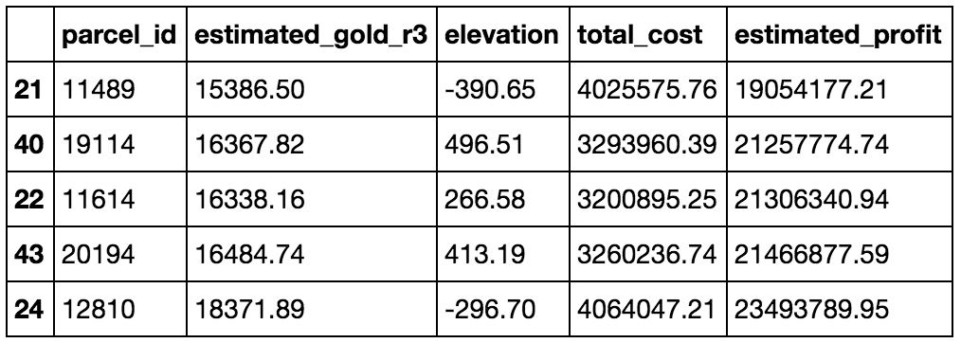
Match best parcels yielded by both methods
Intersect the selected parcels with the ones produced by clustering
Select the top 5 most promising parcels

Slide 13
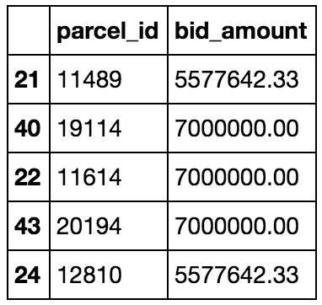
Bidding strategy using empirical Gaussian distribution
Remove the gold extraction costs for the selected 5 parcels from the total budget
Bid more for the middle 3 parcels

Slide 14
El Dorado 2.0
Run the second filtering on the parcels from the optimal cluster instead of all the parcels
Try a different bidding strategy
Using classifiers to predict to which cluster a parcel belongs to
Verify results :)
Code
https://github.com/mihaitodor/el_dorado

Slide 15

THANK YOU

